Slide 1

Glossier.
“Beauty products inspired by real life.”

Slide 2
Table of contents
01.
Identify Brand
02.
Members
03.
Reasoning
What is Glossier?
Who are we?
Why Glossier?

Slide 3
01.
Identify Brand
What is Glossier?

Slide 4
What is Glossier?
Glossier is a beauty brand focusing on natural look makeups, as well as skin and body care products. The products turned from social media to magazines such as Forbes, Time, and Vogue. Glossier makes products designed with customers' real beauty routine in mind. It provides skincare, makeup, body care and fragrance, all painstakingly perfected to be worthy of Customer's bathroom shelf.
Notes:
https://www.honestbrandreviews.com/reviews/glossier-review/

Slide 5
History of Glossier
Glossier was founded in 2014. The brand launched on a beauty website called Into the Gloss. Glossier has been growing ever since, currently having over 2.7 million followers on Instagram.
Notes:
https://www.forbes.com/sites/pamdanziger/2018/11/07/5-keys-to-beauty-brand-glossiers-success/?sh=1f63e2e7417d

Slide 6
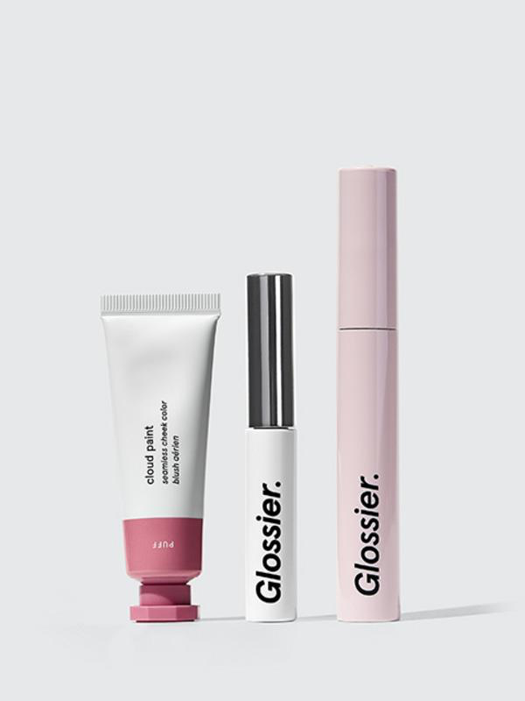
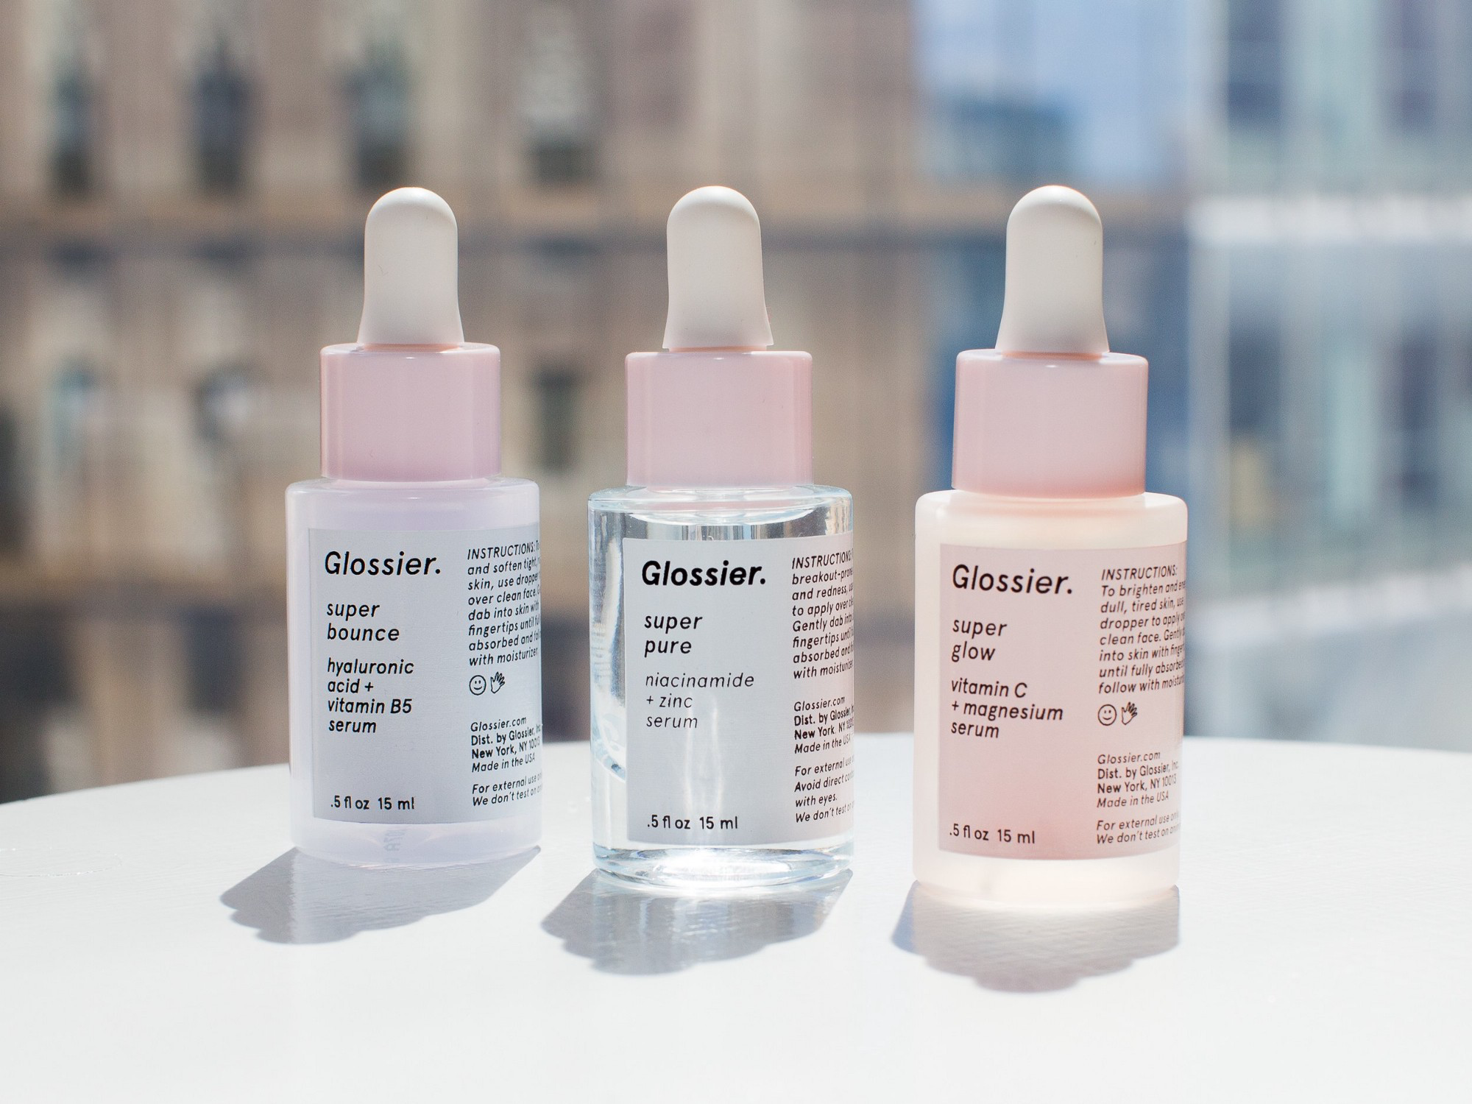
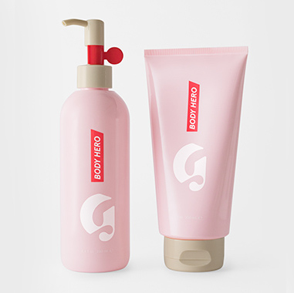
Products
Makeup
Skincare
Bodycare

Slide 7
02.
Members
Who are we?

Slide 8
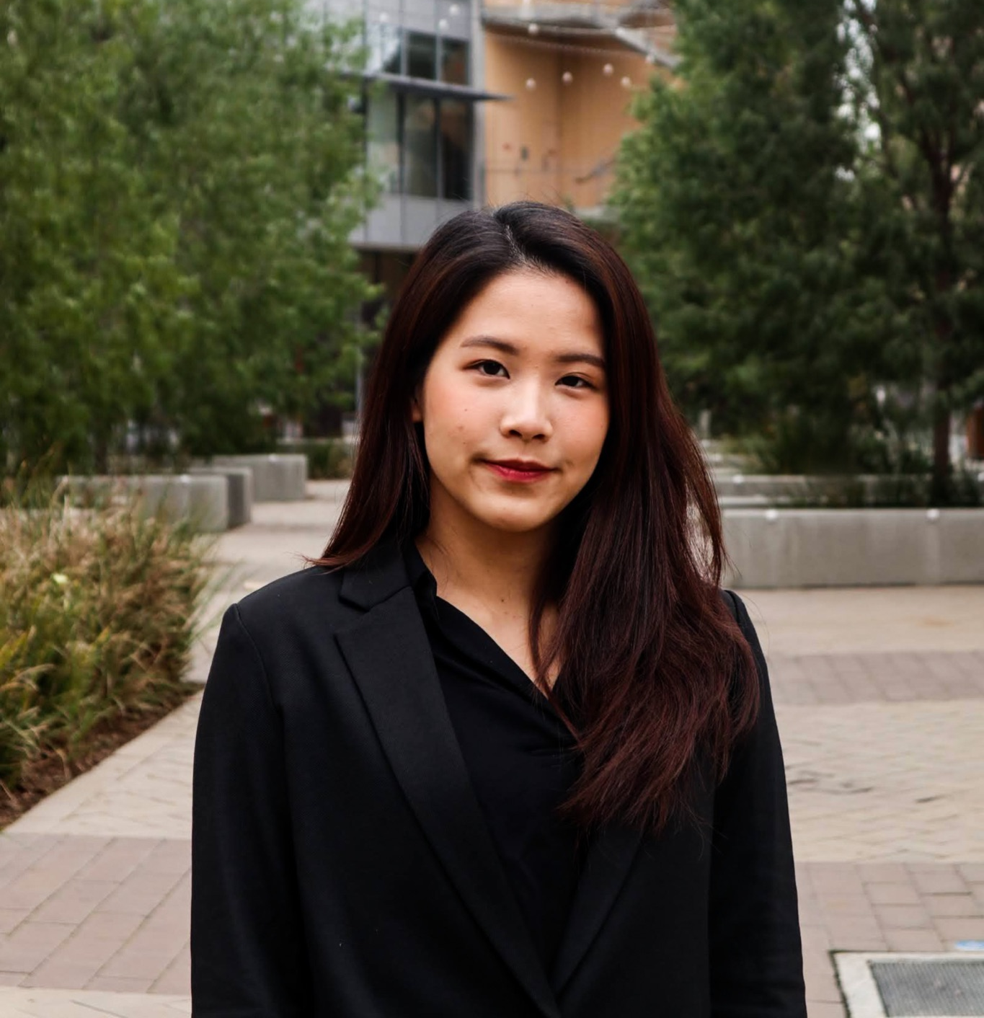
About me
Natcha Watanaharuetai
2nd year
Business Administration
she/her/hers

Slide 9
About me
Ly Heng Teng
4th year
Business Information Management
he/his/him

Slide 10

About me
Hyunbin Im
3rd year
Business Administration
She/her/hers

Slide 11

About me
Farah
Ahmed
2nd year
Computer Science
she/her/hers

Slide 12

About me
Yiting Yin
3nd year
Business Administration
she/her/hers

Slide 13

About me
Isabel
Mercado
Third year
Business Information Management
she/her/hers

Slide 14

About me
JiaJun Gu
Third year
Business Administration & Business Econ
he/his/him

Slide 15

Mohammad Reza Asion
About me:
Transfer student from San Jose City College.
Business Major.
Personal Banker at Wells Fargo Bank.
He/His/Him

Slide 16
03.
Reasoning
Why Glossier?

Slide 17
Why Glossier?
Reason 1
Glossier low-budget, high quality products primarily targets young-adults
Reason 2
Glossier celebrates its customers’ natural beauty

Slide 18
Why Glossier?
Reason 3
The customer interaction, the communication between its readers and followers, give Glossier an advantage on branding.
Reason 4
Glossier is the digital-first company which diverges from traditional beauty brands.
Notes:
Natcha will speak

Slide 19
Why Glossier?
Simple and essential choice with a total of 36 different products across skincare, makeup and fragrance, aiming to produce best kind products that become time-essential
Reason 5
Reason 6
It is easy to buy products online. Glossier also two retail stores located in New York and Los Angeles. There are some pop-up shops in other cities

Slide 20
Thanks
Please keep this slide for attribution

